Slide 1
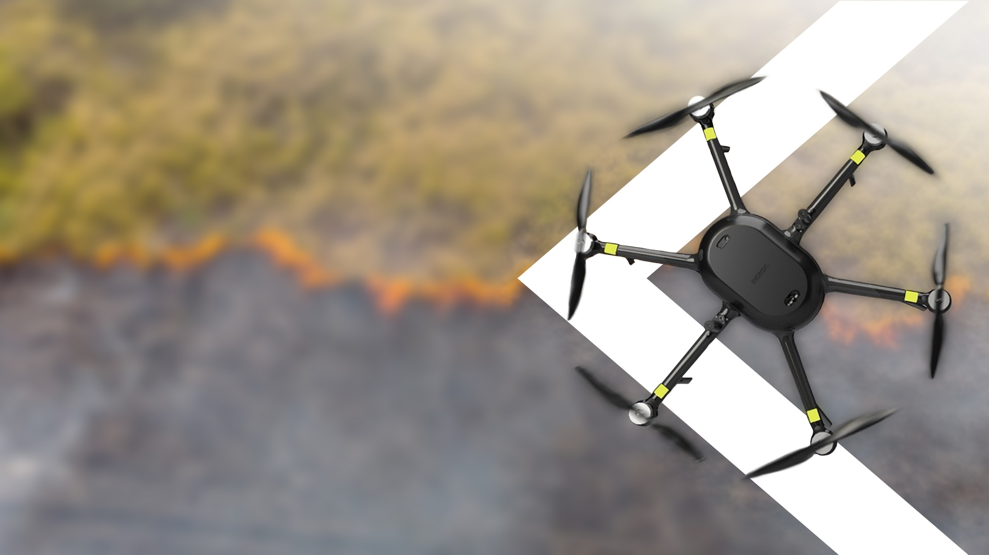

Nokia Drone Networks
Use cases
Name
DD-MM-YYYY
1
© 2023 Nokia
Customer confidential

Slide 2
Nokia Drone Networks in brief
Industrial grade UAVs for professional use
A Nokia product, made in Finland
Integrated GPU, onboard applications
4G & 5G data collection and processing
Open APIs for full automation
CE & FCC Certification as UAV and 4G/5G UE

Slide 3
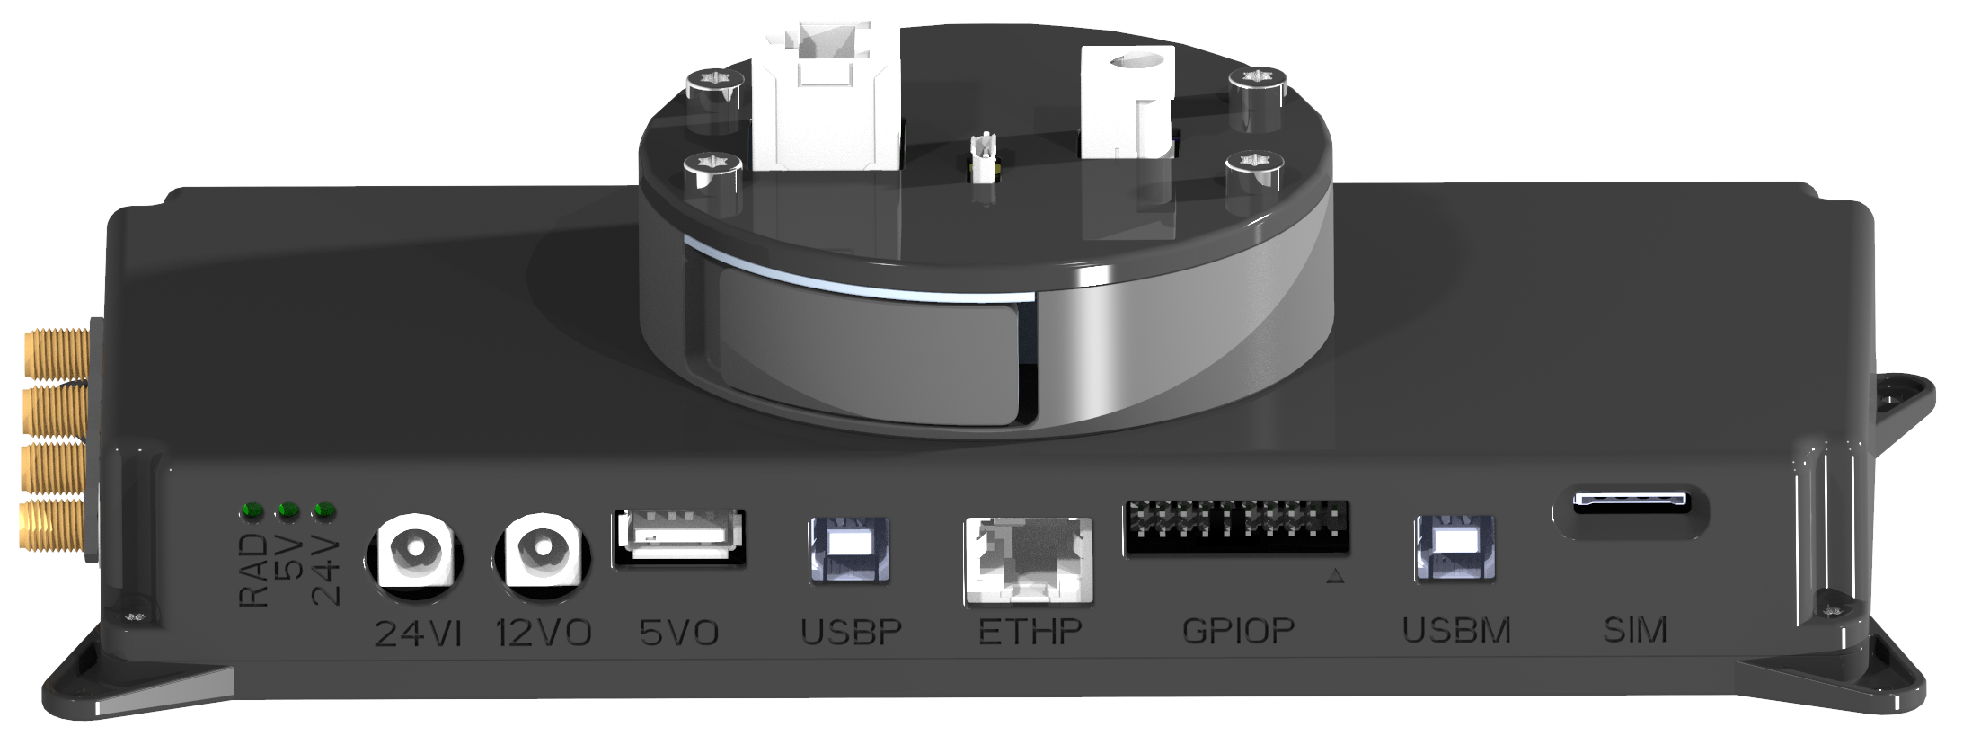
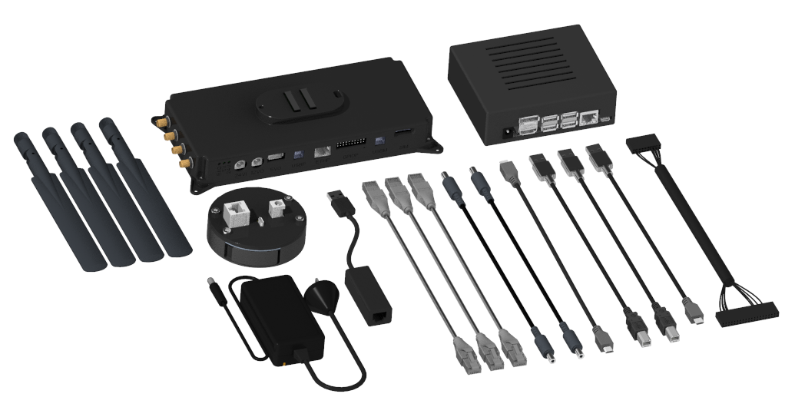
Payload development kit
Enables third parties to develop or integrate their own payloads to Nokia drone
The mechanical and electrical payload interface is the same as in Nokia drone enabling HW integration
Software development kit comes with APIs and drone onboard computer software for SW integration
Nokia’s plug-and-play snap-on module enables easy payload attachment to Nokia drone
Data and power interfaces between payload and the plug-and-play module are easily available via connectors
All necessary HW such as onboard computer developer kit, cables, 4G/5G modem and antennas are included
Onboard computer developer kit
Drone side payload interface
Plug-And-Play

Slide 4

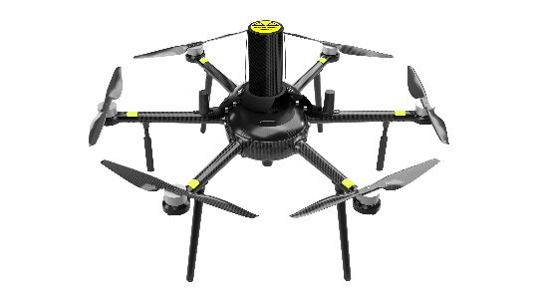
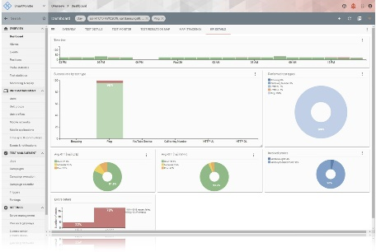
Embedded Rohde & Schwarz QualiPoc
On-board network measurement software
Nokia Drone Networks solution brings the QualiPoc software stack directly onto the drone's onboard computer​
QualiPoc is multifunctional mobile network testing tool for troubleshooting voice and data service quality and RF optimization
It supports all mobile network technologies used worldwide and covers multiple protocol layers as well as the IP stack in real time
The collected data can be viewed in real time on R&S SmartMonitor, a web-based service quality monitoring tool​
NDN drone + QualiPoc
SmartMonitor
5G

Slide 5

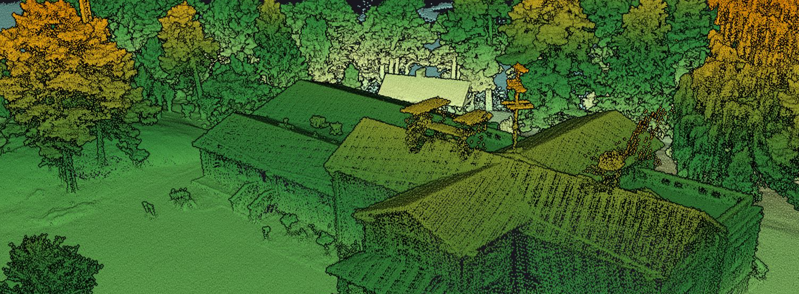
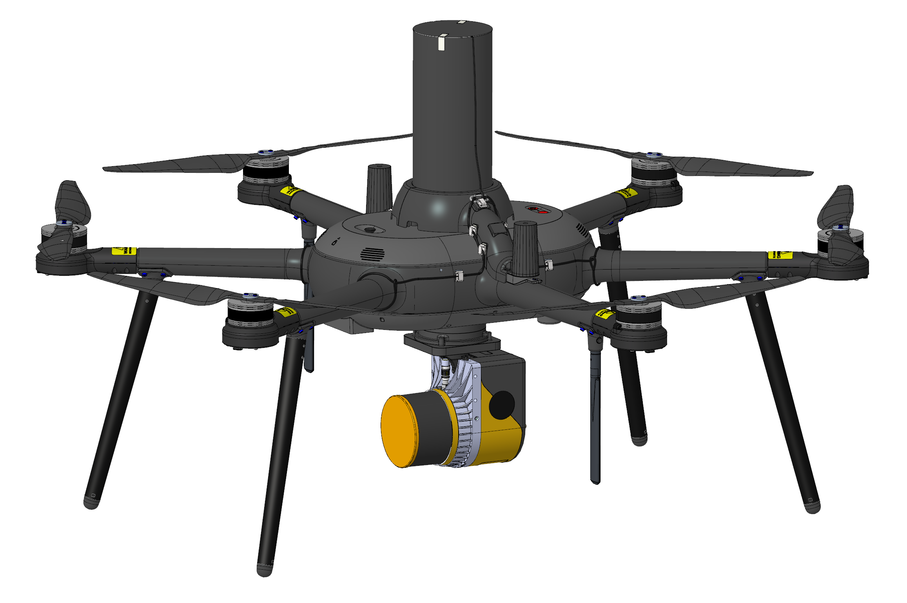
3D lidar scan
Lidar mapping sensor as payload device
Multiple YellowScan mapping lidars as payload options for Nokia Drone
Mapping lidar is a remote sensing technology that uses laser beams to measure and create accurate 3D point clouds
Can be used in variety of applications, including topographic mapping, forestry, mining and telecom tower and power line inspection
The collected data can be post-processed into georeferenced point cloud with up to 2 cm accuracy

Slide 6
Use cases
6
© 2023 Nokia
Customer confidential

Slide 7

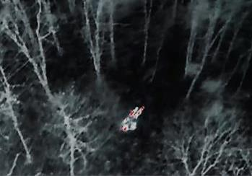
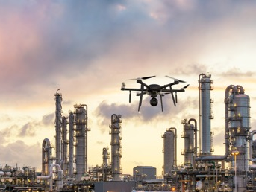
Safety and security
Street safety, emergencies, perimeter security
Street safety
Police drones patrolling streets
Crowd behavior monitoring and analysis
Emergencies
Search for missing person with thermal cameras and UAV fleet
Delivery of medical supplies
Mapping and evacuation route management
Perimeter security
Border inspection
Inspection of closed or industrial areas

Slide 8
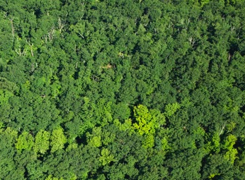
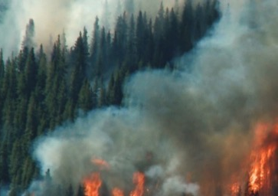
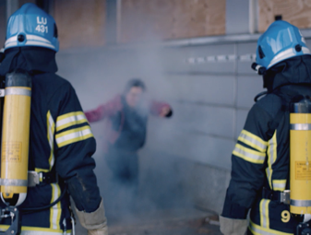
Safety and security
Prevention, firefighting and emergency support
Prevention
Finding hot spots in forests/dry areas to prevent/mitigate larger fire
Fire monitoring in cities
Incident warning
Evacuation route management
Incident and monitoring support
Video streaming improves the situational awareness and supports resource planning, risk evaluation and decision making
Sensors and analytics can identify hazardous substances, i.e. sulfur or chlorine containing gases
Inspection
Verification that a fire is extinguished through HD or thermal video streaming
Gas leakage detection
Damage inspection for insurance

Slide 9


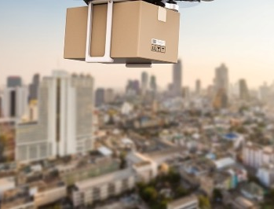
Smart city
Air, traffic and transport
Sensing air quality
Monitoring of air pollution with sensors during scheduled flights
Meteorological measurements
Gas detection
Traffic
Traffic monitoring
Traffic analytics (volume, average speed, accident detection, etc.)
Transport
Last mile delivery
Smart city drone stations as pick-up points for parcels

Slide 10
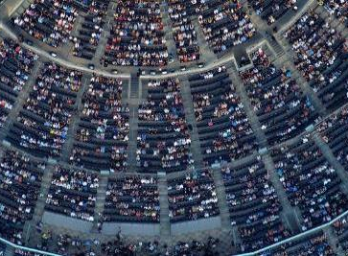
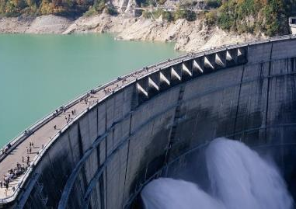
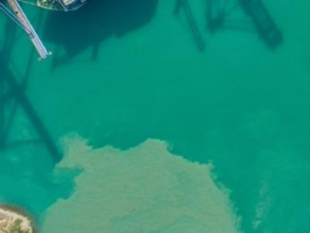
Smart city
Events, construction, and water
Event management
Live video streaming
Event perimeter management, detection of movements
Crowd analytics and monitoring
Infrastructure
Inspection of public buildings, roofs, bridges, railroads, roads
Preconstruction survey, site topography, conditions
Tracking building and road construction progress
Water quality
Detection of oil /chemical leakage
Monitoring of water quality and levels

Slide 11
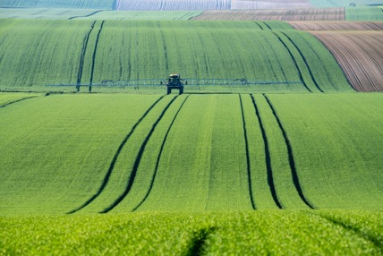
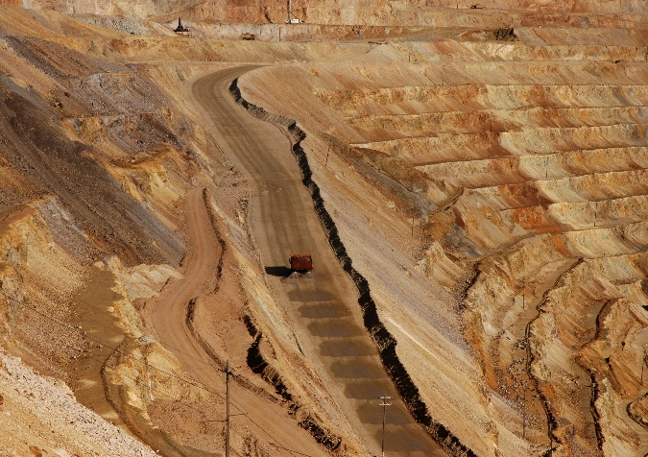
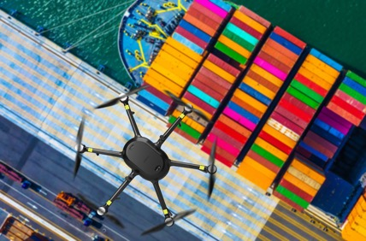
Smart city
Industry and transport
Forest and farming
Crop health inspection for spraying needs
Forest health inspection and inventory
Storm damage inspection
Wildlife/animal movement
Energy, oil and gas, mining
Pipeline leakage detection
Gas sensing
Inspections of air cables
Windfarm turbine inspection
Open pit mine surveillance
Maritime monitoring
Monitoring of harbors, waterways, dams, etc.
Vessel and traffic monitoring
Coastguard and port management support

